Slide 1

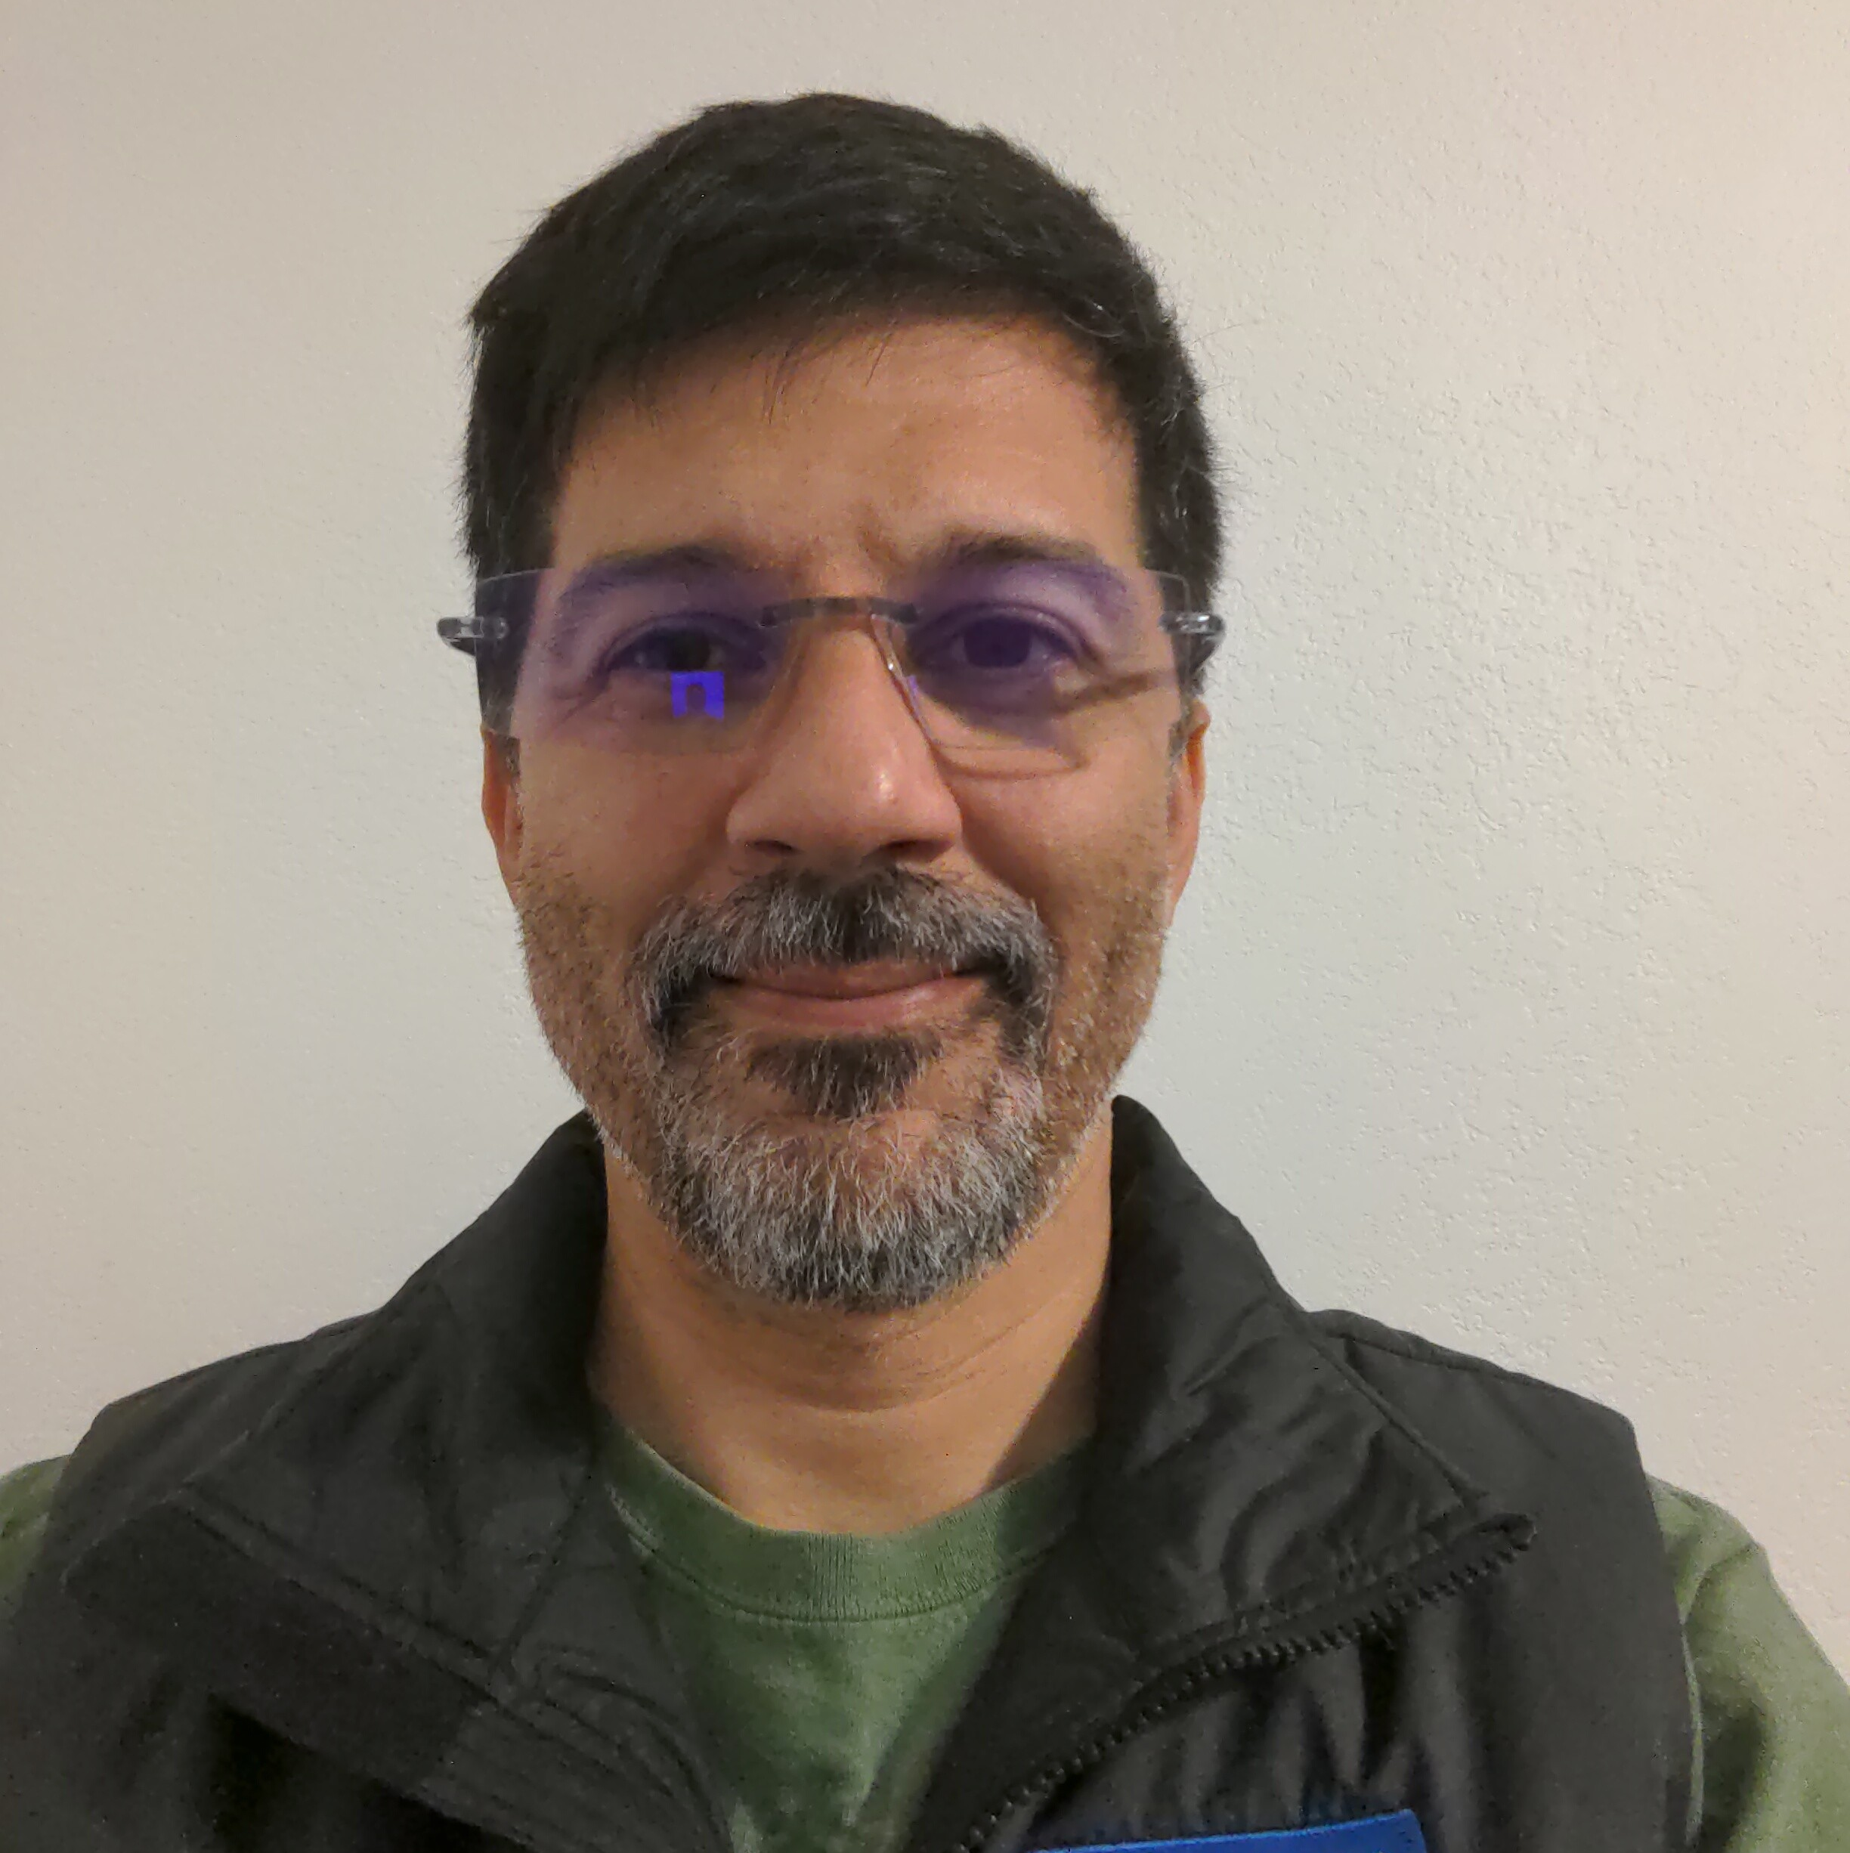
Protect your stateful Kubernetes workloads with Kanister
Michael Cade
Mark Lavi
Global Field CTO
Michael.Cade@Veeam.com
Principal, Cloud Native Product Manager
Mark.Lavi@Veeam.com
Notes:
Veeam RO: https://veeamsoftwarecorp-my.sharepoint.com/:p:/g/personal/mark_lavi_veeam_com/EXVVX3d33m9IlbS25xHCKnoB1wOXhXfadyy5dCrbtuzm3Q?e=aXVAzZ
Public: TBD

Slide 2
Introductions: Michael and Mark
Data Protection on Kubernetes: Overview Kanister project overview and updates
Agenda
Discussion and Demonstration of Kanister.io Blueprints and Visualizer
Conclusions and Resources
Questions and Answers + Thank You!
Notes:
321 slide from Michael, RPO + RTO definitions = Disaster Recovery metrics
Emphasize Kanister helps orchestrate outside the cluster The road ahead: - data protection outside of the cluster with Veeam 3+ seed questions and answers; even plant Q&A in preso talk

Slide 3
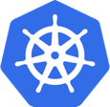
From Stateless to Stateful
v1.0 July 2015
v1.3 July 2016
v1.9 Dec. 2017
v1.13 Dec. 2018
v1.20 Dec. 2020
Today
Stateless applications
Stateful applications and capabilities
“Cattle” PersistentVolumes
Pet Sets Alpha
StatefulSets GA CSI Alpha
CSI GA Operator Framework
VolumeSnapshot GA
Data Service Maturity
86%
14%
started adopting 2+ years ago¹
started adopting in last two years¹
¹ 2022 Data on Kubernetes Report (N=500+)
Notes:
Thanks to Matt Bator for creating this summary of DoK.community report; updated to 2022

Slide 4
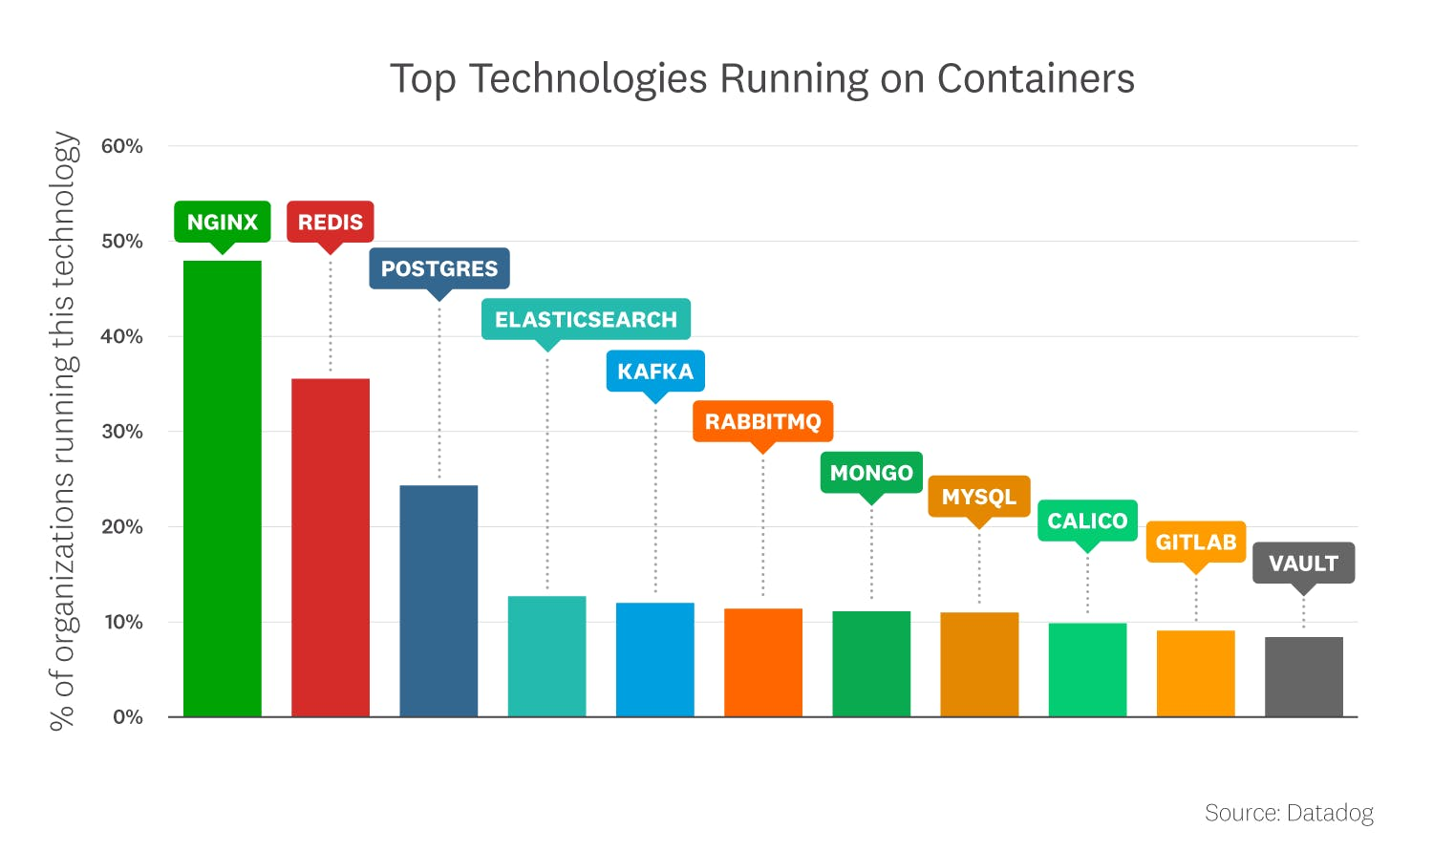
As Kubernetes has matured
Stateful applications are common
Datadog Real-World Container Use Report – Nov 2022
Notes:
Thanks to Matt Bator for creating this summary of DataDogreport
Why would people want to run on cluster?
Duplicating work and in turn reducing value of your Kubernetes investment, potentially detracting from your organization’s goals in adopting container orchestration
The downside is that by maintaining a non-Kubernetes resource outside your cluster, you need to have a way of monitoring processes, performing configuration management, performing load balancing and service discovery for that application. You are essentially duplicating work by setting up a parallel software workflow outside Kubernetes.
1.5+ billion containers
10,000+ Datadog customers
The same report also saw increases in usage of statefulsets and PVCs
Tie in ”we use CI/CD for all of our app deployments” – doesn’t solve for data gravity for things like app mobility when storing state outside of cluster
Praveen – the apps are still doing something with data – do you have a DR plan, how do you deal with recovery for those stateless apps, compliance for these apps? They’re stateless in that they’re focusing on apps running Kubernetes, but the overall environment is not. The critical thing is RECOVERY EXPERIENCE - could be a collection of scripts and they’re OK with it, knowing at scale it will get out of hand but they’re not there yet.
We provide the assurance, the reporting, the ability to easily test.
At shows they only have a few minutes to understand what we do – hard to pack in that value
From Praveen - If we can help make the value prop more concise to deliver faster
If you run into Devs, they’re isolated from being responsible for data protection, so they don’t get the value or risk – how do we get these personas to go back to their teams and influence. Providing proof of compliance, you’ve got a script that one person wrote – have you ever inherited someone else’s code?

Slide 5
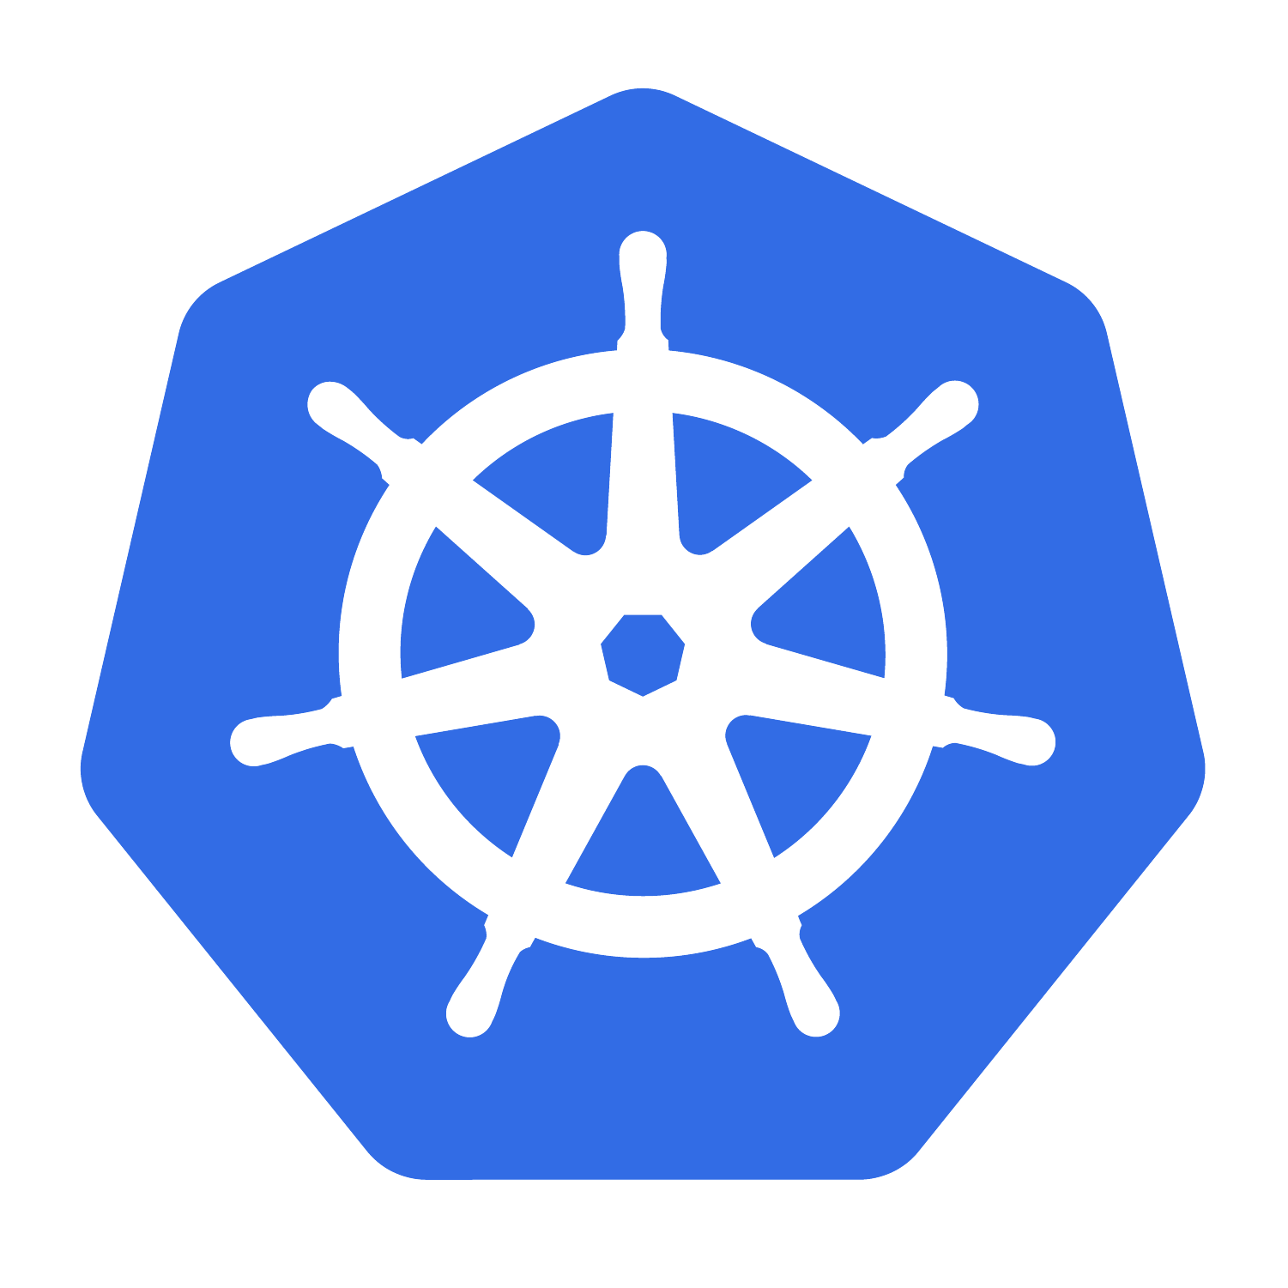


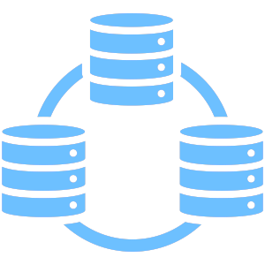
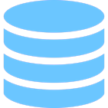
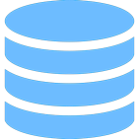
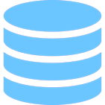
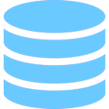

Cloud Native Deployment Patterns
Multiple paths to providing data persistence
Application using data services outside of Kubernetes
Data services in Kubernetes – separate from Application
Application includes
data services – all in Kubernetes
Kanister.io
Notes:
‘Stateless apps do not exist’ is a misnomer.
There are just several deployment patterns for state and databases are some of the most popular workloads in K8s.
Running A Stateful Application Outside of Kubernetes
Running A Stateful Workload as a Cloud Service
Running your Stateful Workload Inside Kubernetes

Slide 6
Kubernetes: Stateful versus Stateless Workloads
Myth 1: Everything is stateless on Kubernetes!
Kubernetes cluster and application configuration as well as etcd, have state
Secrets, RBAC, DNS, etc.
CNCF Study 2020: 55% of respondents running stateful workloads:
Databases
Virtual Machines (https://KubeVirt.io)
Audit requirements unsatisfied: proof of point in time cluster state configuration
Myth 2: With GitOps, if I lose a cluster, I get a new one and redeploy my applications.
A variation on the above; does not satisfy persistence, data operations, audit, and …
Disaster Recovery (DR): backup artifacts must leave the cluster; clusters are cattle
Myth 3: With public cloud, I am protected.
Public clouds have outages, they recommend disaster recovery!

Slide 7
Why etcd Backup is a Poor Strategy
Myth: Backing up etcd is needed for Kubernetes!
While good for forensic and audits, in practice, nobody:
restores etcd in production
can easily extract etcd content
Because cluster state constantly drifts, etcd restoral will fail to bring the cluster back perfectly, requiring further remediation.
Conclusion: you are only as good as your last etcd restoral; test this myth.

Slide 8



3-2-1 Backup Rule
Different Copies
Of Data
Different Media
Of which is offsite
https://community.veeam.com/blogs-and-podcasts-57/3-2-1-1-0-golden-backup-rule-569

Slide 9
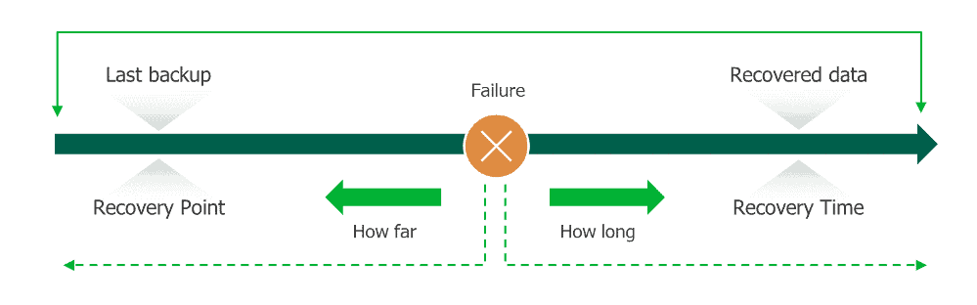
Disaster Recovery is Measured with RPO+RTO

Slide 10
What is an Application Consistent Backup?
Direct
Generic
Snapshot
Logical
System
Myth: CSI VolumeSnapshot is good enough to backup my Persistent Volumes!
Direct: using Storage Provider volume snapshots
Generic: mount a filesystem, backup every file
Snapshot: CSI VolumeSnapshot
Problem: All the above are not crash consistent until the application and data are at rest
Logical: Application utility used for backup (e.g.: MySQLdump)
Problem: constantly growing monolithic file or BLOB, not incremental
System: Lock application, flush buffers to storage, CSI VolumeSnapshot, and unlock
Best of both worlds; can be made incremental to save time and storage
Requires orchestration across multiple domains (app, cluster, storage)!
Conclusion: backup on Kubernetes requires orchestration, performance, storage efficiency, and application considerations to achieve 3-2-1 and RTO+RPO outcomes.
Notes:
Application Consistent Backup is the goal and an umbrella term; it can be accomplished by different methods, depending on the application requirements. By progressively getting closer to the application, backup and recovery can improve RPO, RTO efficiencies and overcome infrastructure only limited methods.

Slide 11
Kubernetes Challenges for Backup and Recovery
Infrastructure Challenges
Managing Backup and Recovery
Switch from AWS S3 to Azure blob storage?
Deal with operations over a fragile network connection? (Mobile, edge)
Manage incremental backup of your PVC?
Discover the content of a secret, deployment, or any object without unmaintainable JSONpath expressions, such as: '.metadata.annotations.kubenetes.io/hostname}'
how do you wait for a scale down or a scale up operation, how do you wait for a status before switching to the next action ?
how do retrieve in a consistent manner credentials of your backup location ?
log all operations in a single place?

Slide 12
What is Kanister?

Slide 13

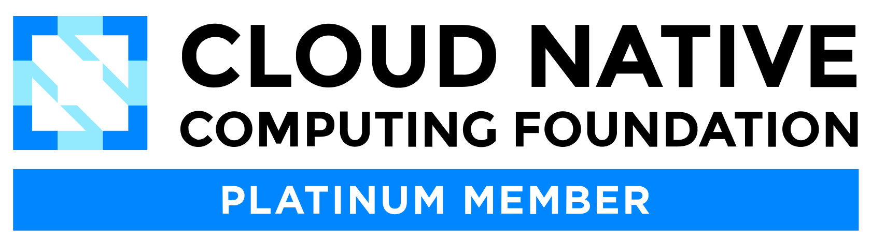
Kanister.io is now a CNCF.io Sandbox Project!
Application consistent backup and recovery orchestration for everyone
Project Status:
2017: Created & launched @ KubeCon NA
2023-06-20: Submitted to CNCF
2023-09-19: Vote passes for Acceptance https://github.com/cncf/sandbox/issues/46
Project Onboarding: https://github.com/cncf/toc/issues/1172
Sandbox
Incubating
Graduated
CNCF Project Maturity:
Notes:
Project maturity: Sandbox addresses a problem, but early in community adoption; Incubating has diversity of maintainers for sustainability with growing adoption and features; Graduated indicates stable APIs and features, wide adoption in production: e.g.: Helm.sh

Slide 14








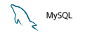

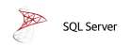



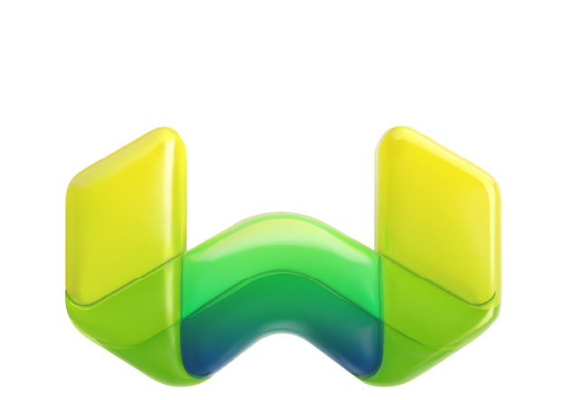
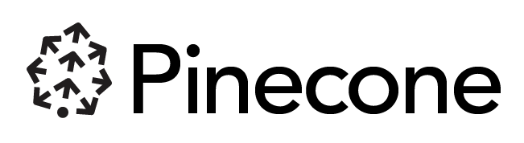

Kanister Contribution to CNCF (Sandbox)
Data on Kubernetes Growth
Databases (SQL/NoSQL) lead the growth of stateful workloads on Kubernetes, database diversity and deployments continue to increase data protection requirements
kanister.io
Kanister.io
Data protection operations in a cloud native, extensible manner for application consistent backup and recovery. Kanister has been an open source project and community since 2017.
Kanister community blueprints:
Amazon RDS
Cassandra
PostgreSQL
MySQL
MongoDB
SQL Server
K8ssandra
Elasticsearch
Rapid Release and Innovation
0.94 Prometheus metrics, OCP 4.13 support, Grype security scanner
0.92 MongoDB Atlas blueprint
0.91 OCP 4.12 support, AWS RDS Postgres blueprint
0.90 Kopia controller, Incremental Elastic blueprint
Growing database diversity, e.g., Vector databases
Weaviate

Slide 15
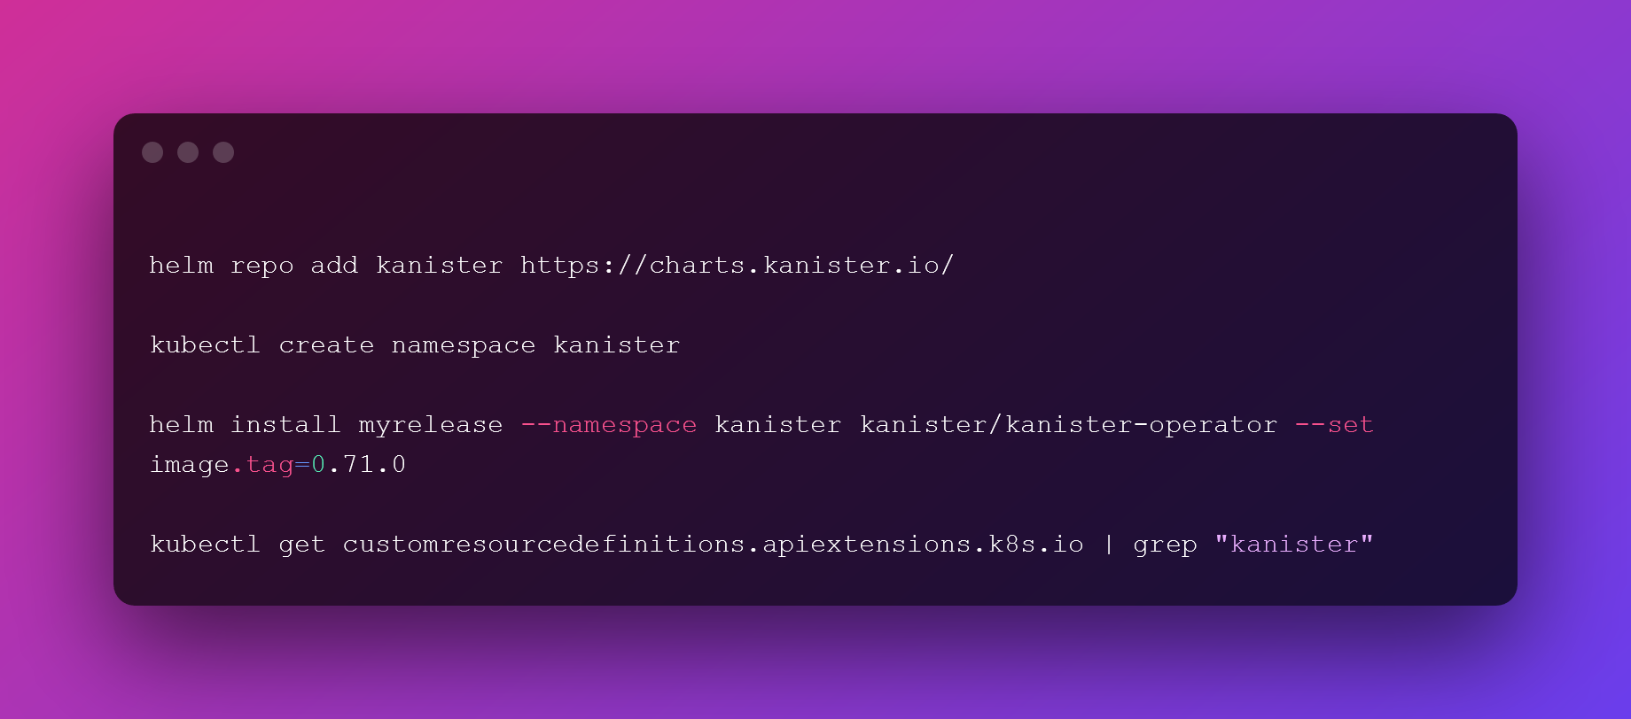
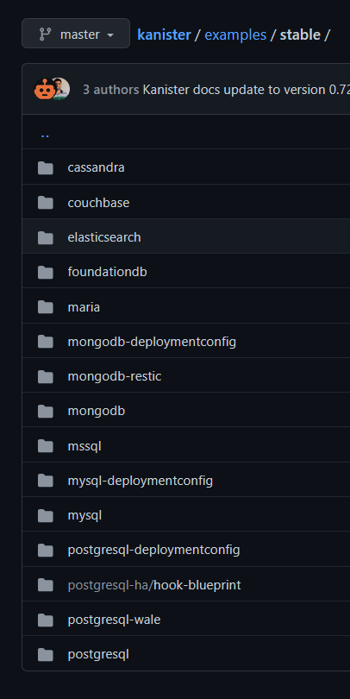



Execution Walkthrough
Controller
Database Workload
Blueprint

Slide 16
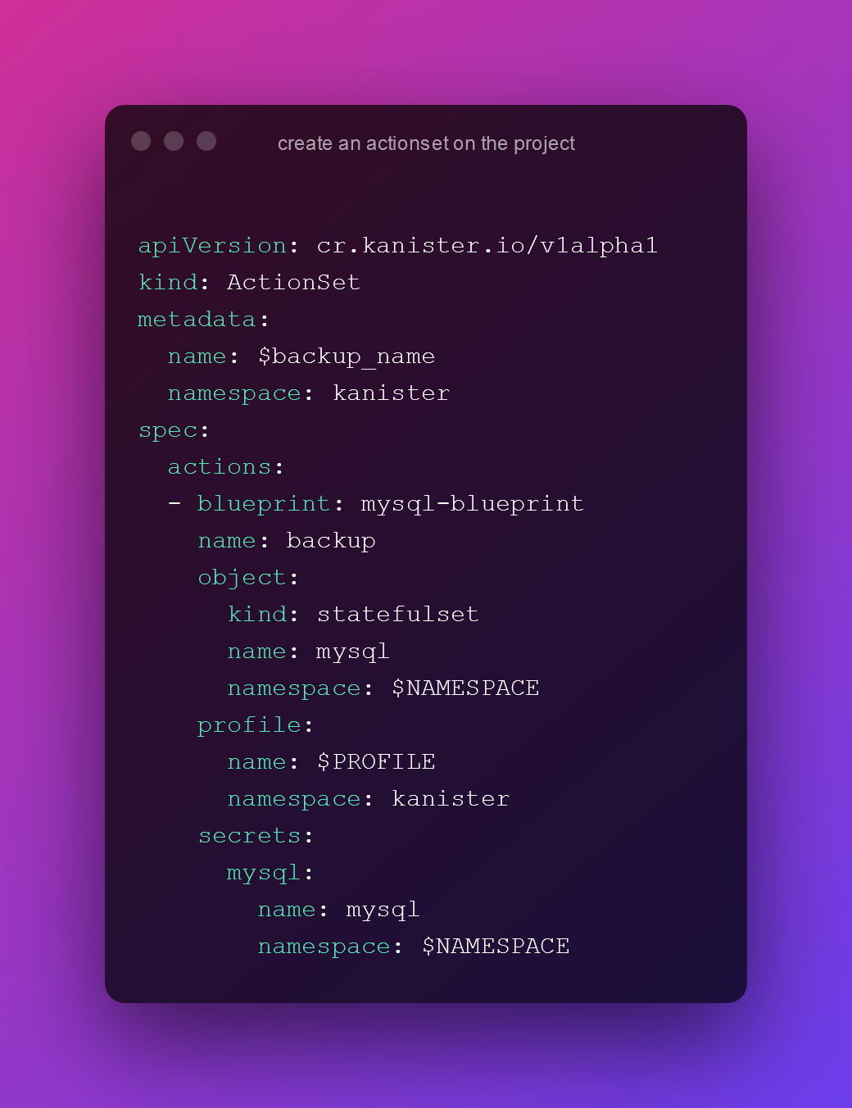

Execution Walkthrough
Controller
ActionSet
Database Workload
Blueprint

Slide 17
Execution Walkthrough
Controller
ActionSet
Database Workload
Blueprint

Slide 18

Execution Walkthrough
Controller
Kanister Function
ActionSet
Database Workload
Blueprint

Slide 19

Execution Walkthrough
Object Storage/
Cloud Snapshot
Controller
Kanister Function
ActionSet
Database Workload
Blueprint

Slide 20
Execution Walkthrough
Object Storage/
Cloud Snapshot
Controller
ActionSet
Database Workload
Blueprint

Slide 21
Breaking down the blueprint

Slide 22
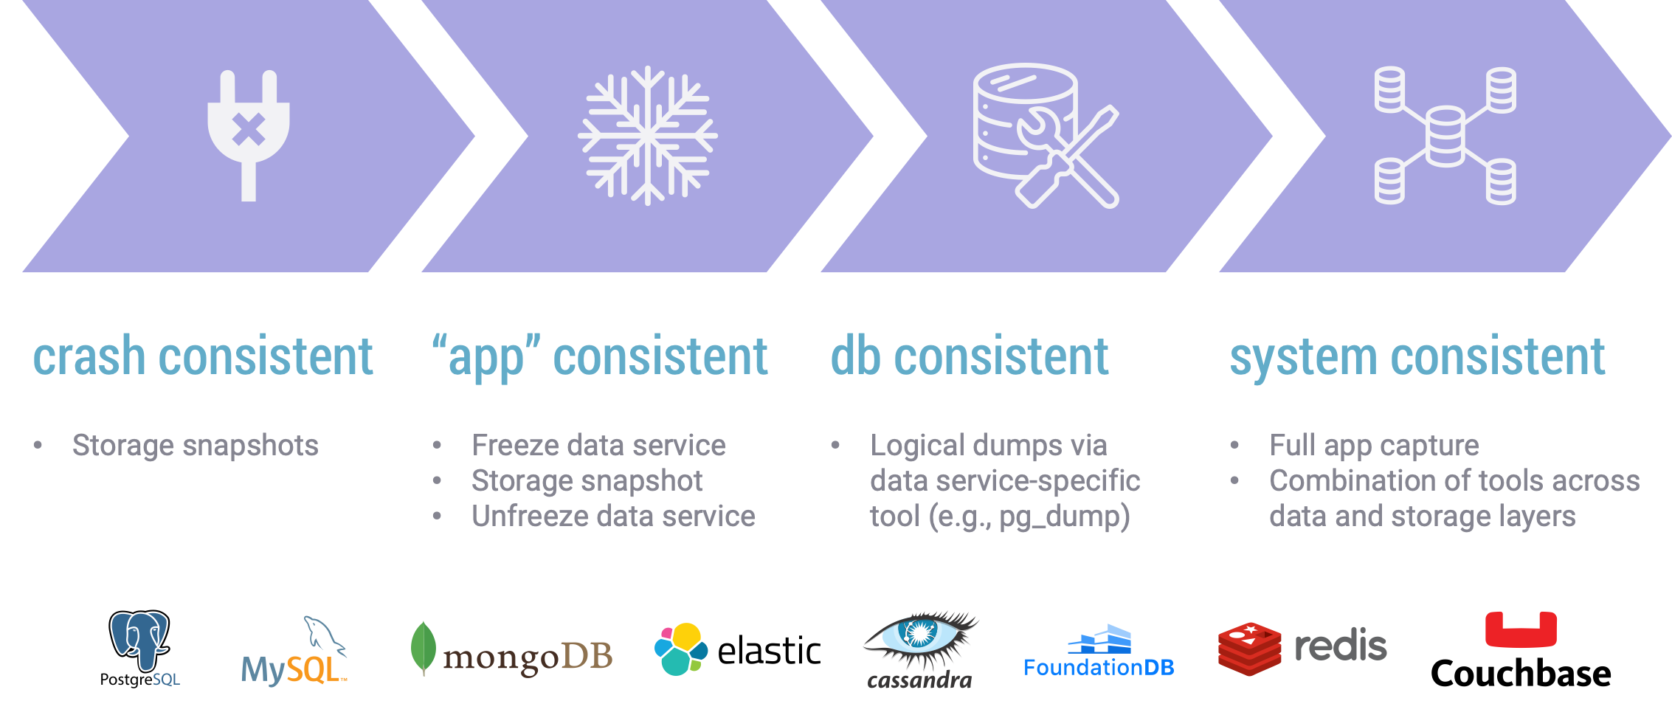
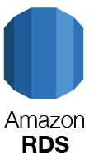
Kasten K10 Consistency Spectrum for Data Services
Crash Consistent
“app” Consistent
db Consistent
System Consistent
Storage snapshots
EBS and EFS
Freeze data service
Storage snapshot
Unfreeze data service
Logical dumps via data service-specific tool (e.g., pg_dump)
Full app capture
Combination of tools across data and storage layers

Slide 23
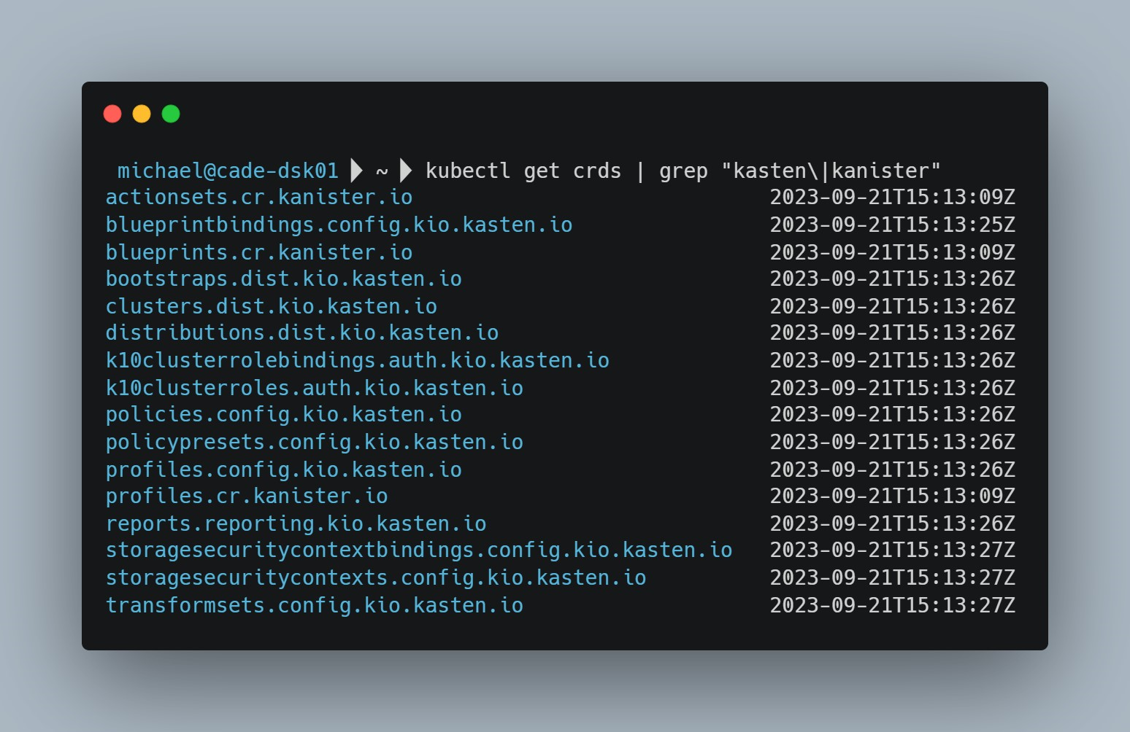
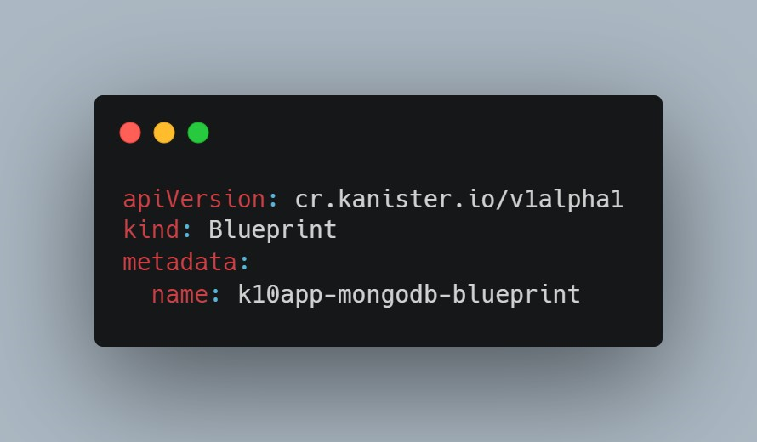
Blueprints are Custom Resources
k10app-mongodb-blueprint.yml

Slide 24
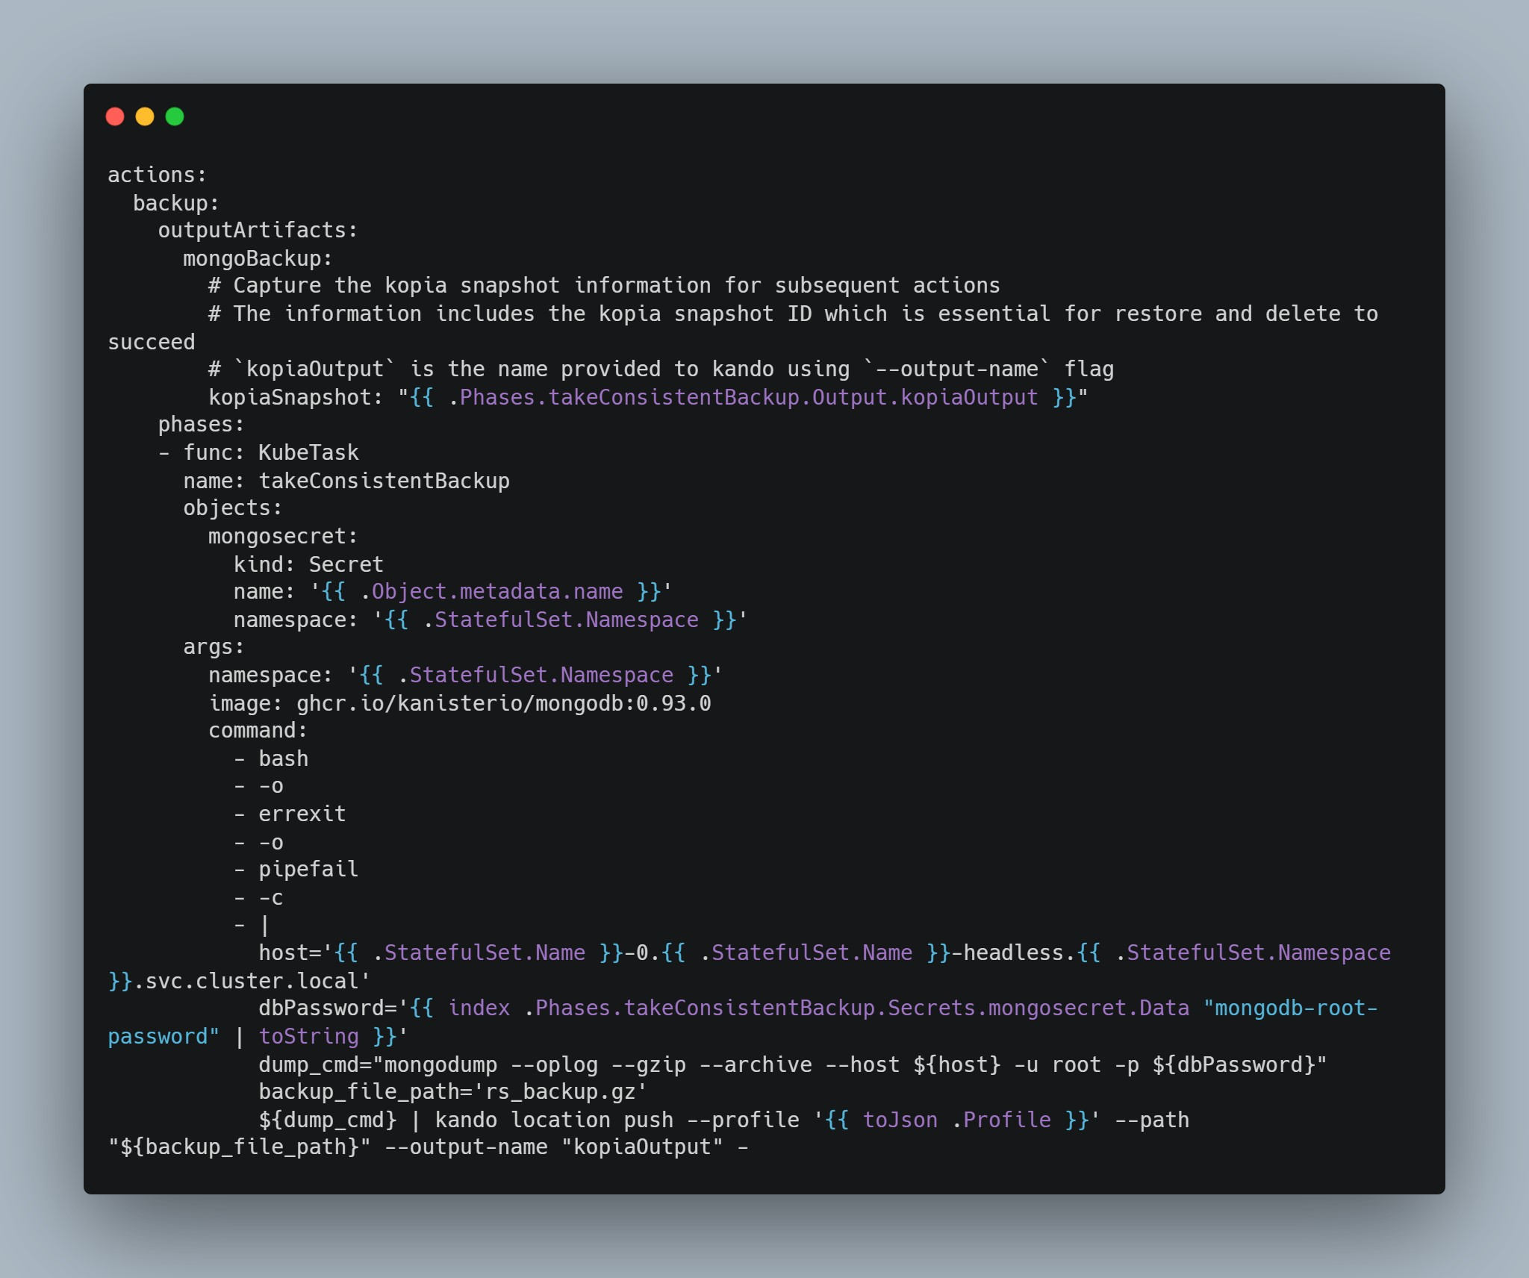
Blueprints have actions: Backup
k10app-mongodb-blueprint.yml

Slide 25
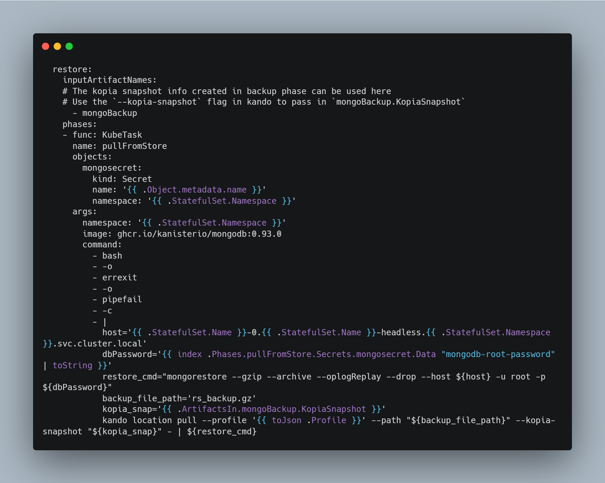
Blueprints have actions: Restore
k10app-mongodb-blueprint.yml

Slide 26
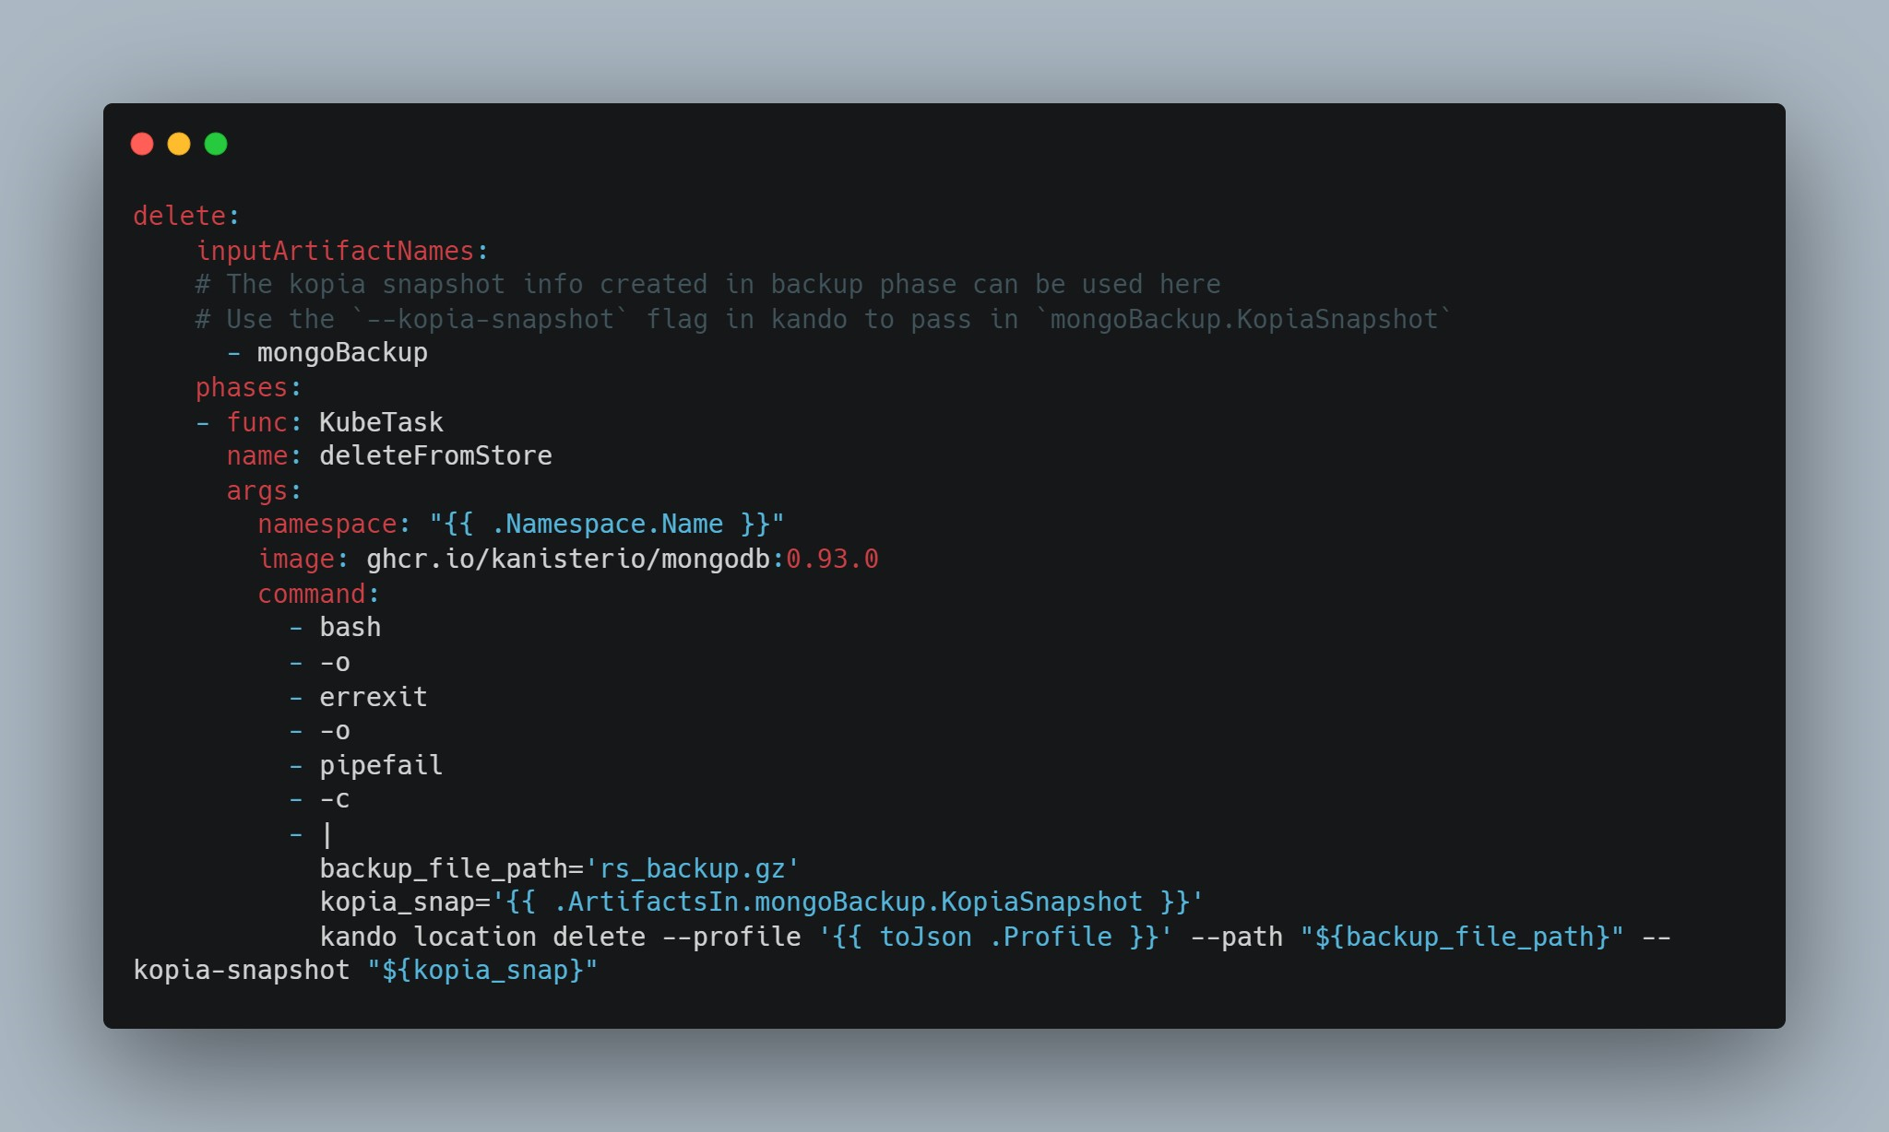
Blueprints have actions: Delete
k10app-mongodb-blueprint.yml

Slide 27
The Kanister Visualiser

Slide 28
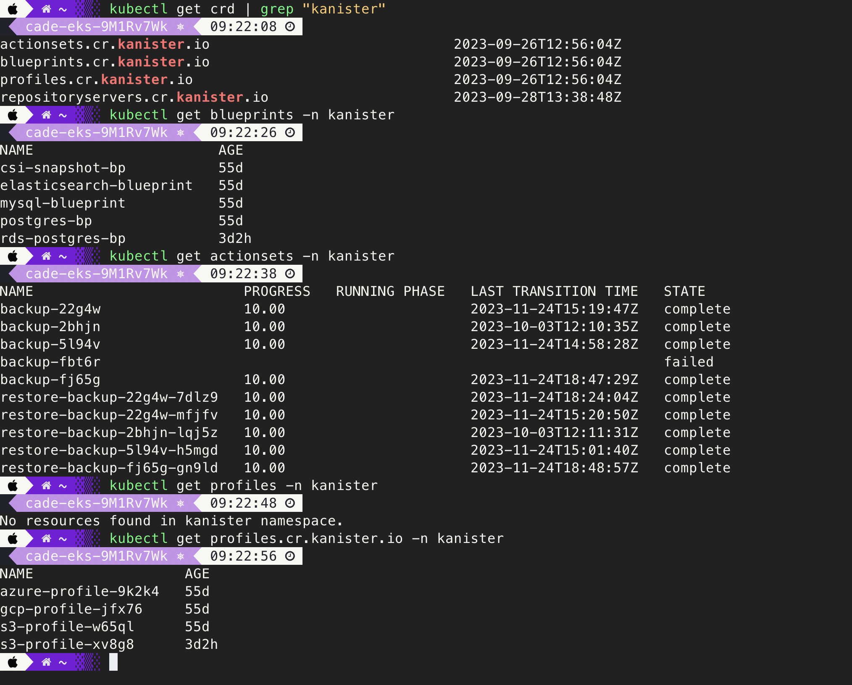
Command Line is great…

Slide 29
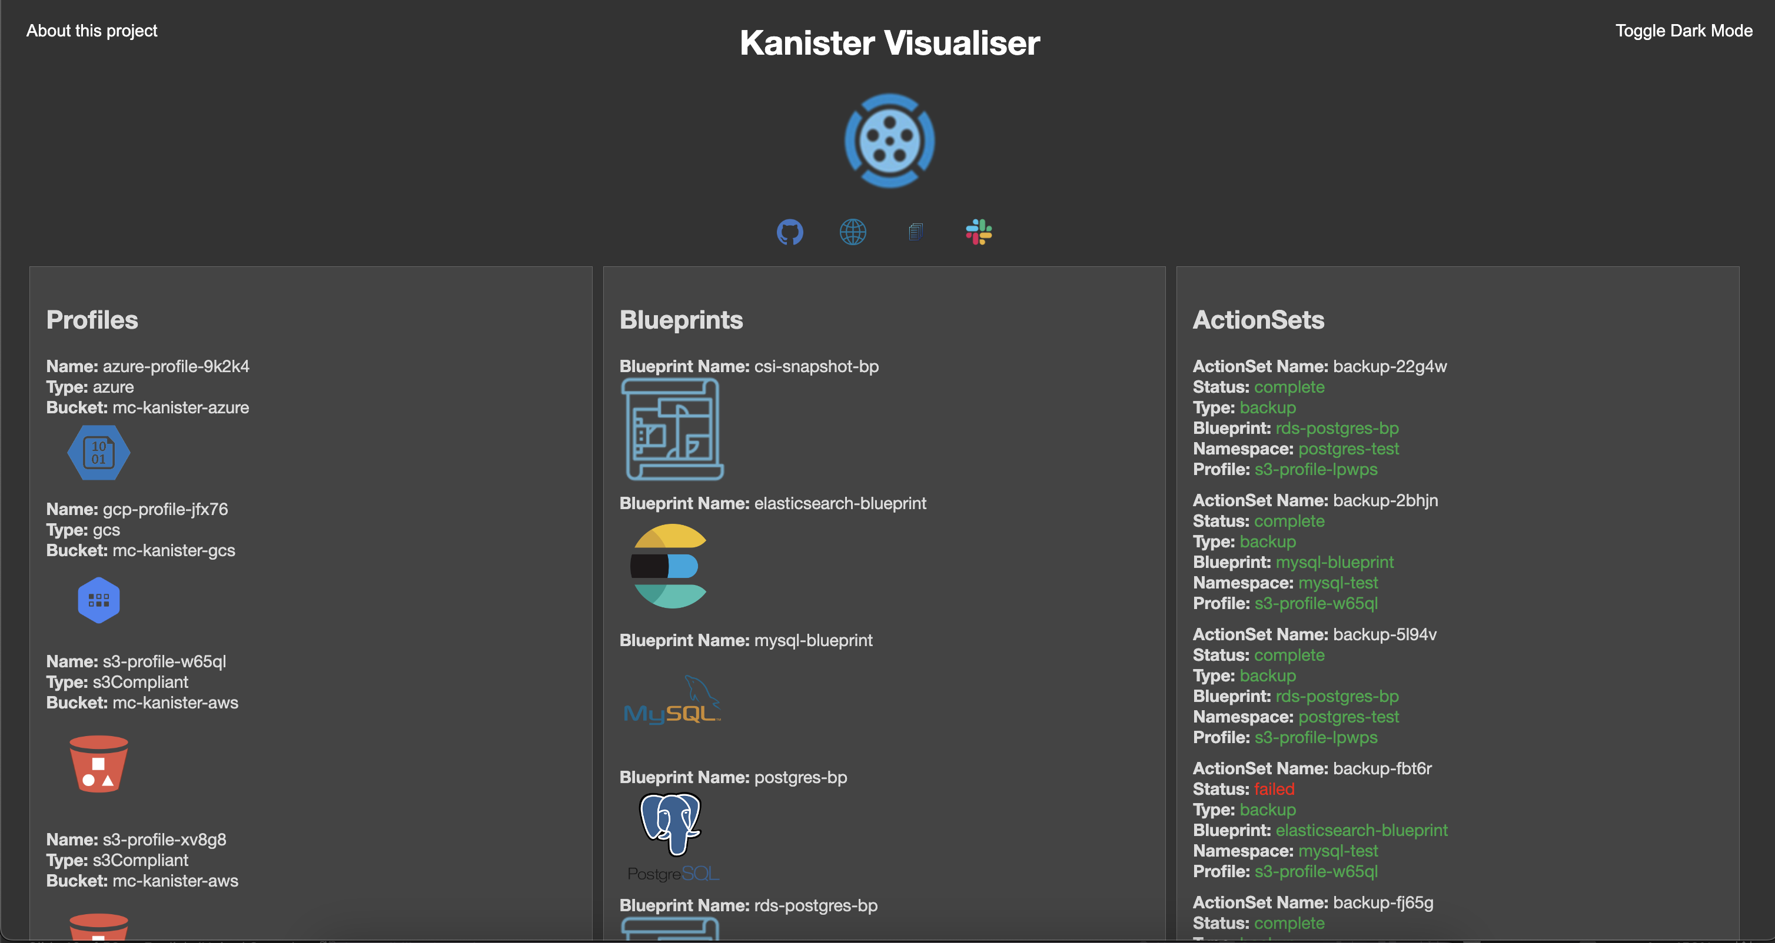
I wanted a way to Visualise these resources

Slide 30
Navigation

Slide 31
Profiles

Slide 32
Blueprints

Slide 33
ActionSets

Slide 34
Demo

Slide 35
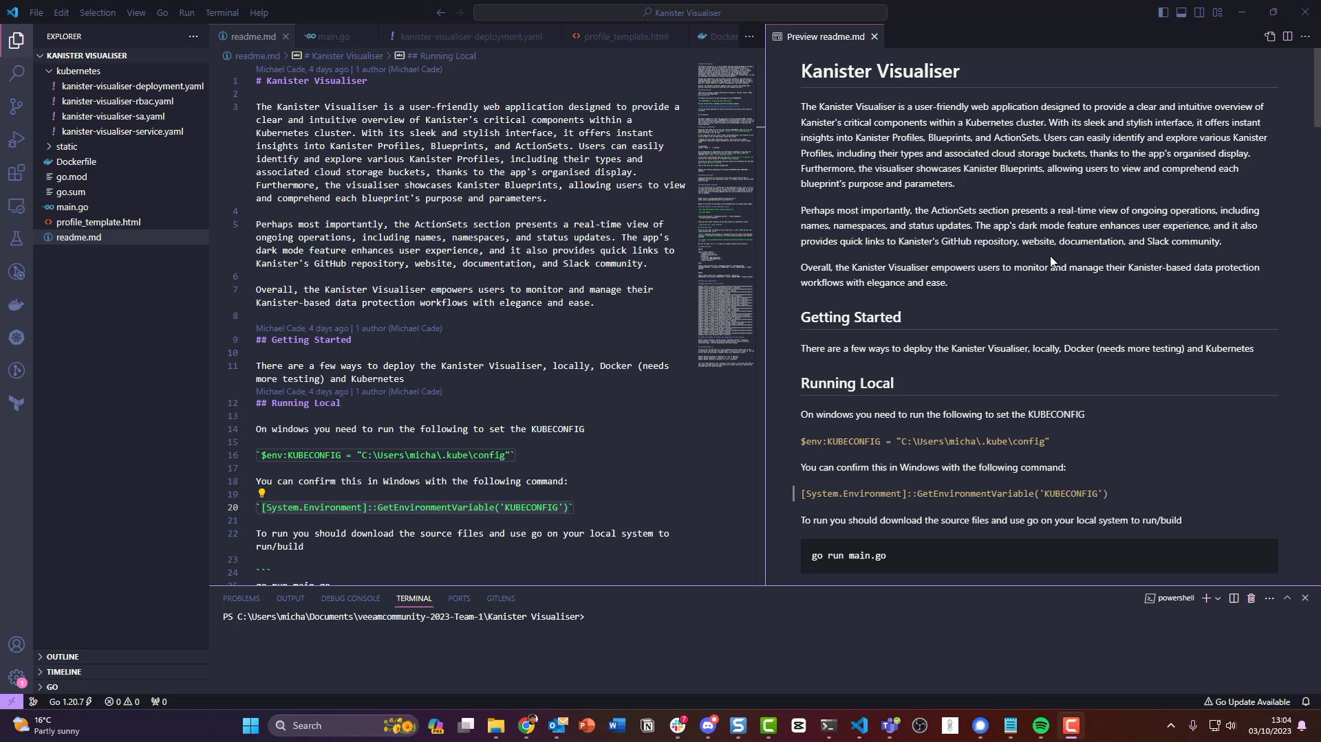

Slide 36
Conclusion

Slide 37

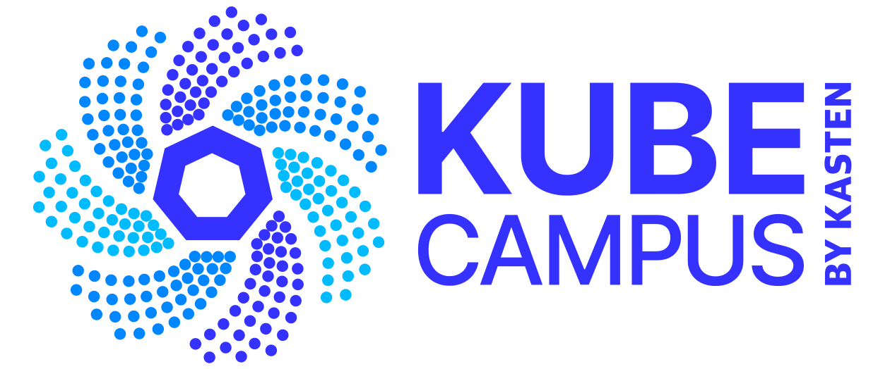
Kanister.io Resources
Please join the project and adopt Kanister to achieve app consistent backup!
https://Kanister.io for code, documentation, issues, and bi-weekly community meetings + Slack Example blueprints: https://github.com/kanisterio/kanister/tree/master/examples
White Paper (registration on Kasten.io): Conquer Data Consistency with Kasten K10 by Veeam and Kanister.io Blueprints
Hands on Lab: KubeCampus.io/kubernetes/courses/application-consistency/
Veeam Press Release announcing Kanister.io CNCF Sandbox Project
References:
https://www.cncf.io/wp-content/uploads/2020/11/CNCF_Survey_Report_2020.pdf
https://dok.community/wp-content/uploads/2022/10/DoK_Report_2022.pdf
https://www.datadoghq.com/container-report/

Slide 38
Questions?

Slide 39
Thank You

